Slide 1
User Interface Components
Lecture # 5
From:
http://www.usability.gov/how-to-and-tools/methods/user-interface-elements.html

Slide 2
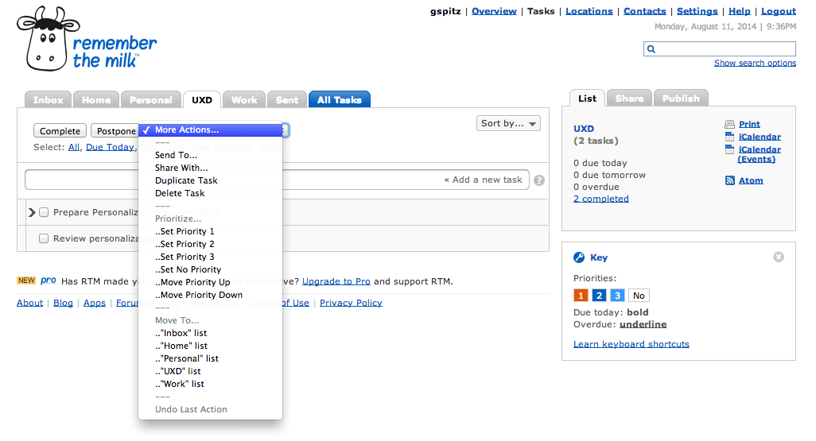

Slide 3
Interface Elements Categories
Input Controls
Navigational Controls
Informational Components
Containers

Slide 4
Input Controls

Slide 5
Checkboxes
Checkboxes allow the user to select one or more options from a set. It is usually best to present checkboxes in a vertical list.
More than one column is acceptable as well if the list is long enough that it might require scrolling or if comparison of terms might be necessary.

Slide 6
Radio buttons
Radio buttons are used to allow users to select one item at a time.

Slide 7
Dropdown lists
Dropdown lists allow users to select one item at a time, similarly to radio buttons, but are more compact allowing you to save space.
Consider adding text to the field, such as ‘Select one’ to help the user recognize the necessary action.

Slide 8
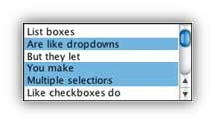
List boxes
List boxes, like checkboxes, allow users to select multiple items at a time, but are more compact and can support a longer list of options if needed.

Slide 9
Buttons
A button indicates an action upon touch and is typically labeled using text, an icon, or both

Slide 10
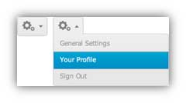
Dropdown Button
The dropdown button consists of a button that when clicked displays a drop-down list of mutually exclusive items.

Slide 11
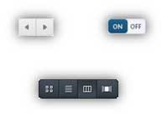
Toggles
A toggle button allows the user to change a setting between two states.
They are most effective when the on/off states are visually distinct.

Slide 12
Text fields
Text fields allow users to enter text.
It can allow either a single line or multiple lines of text

Slide 13
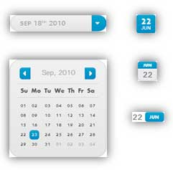
Date and time pickers
A date picker allows users to select a date and/or time.
By using the picker, the information is consistently formatted and input into the system.

Slide 14
Navigation Components

Slide 15
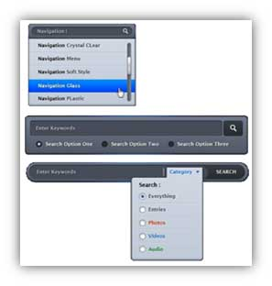
Search Field
A search box allows users to enter a keyword or phrase (query) and submit it to search the index with the intention of getting back the most relevant results.
Typically search fields are single-line text boxes and are often accompanied by a search button

Slide 16
Breadcrumb
Breadcrumbs allow users to identify their current location within the system by providing a clickable trail of proceeding pages to navigate by.

Slide 17
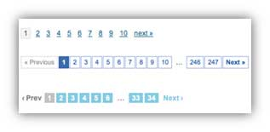
Pagination
Pagination divides content up between pages, and allows users to skip between pages or go in order through the content.

Slide 18
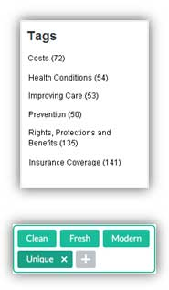
Tags
Tags allow users to find content in the same category. Some tagging systems also allow users to apply their own tags to content by entering them into the system.

Slide 19
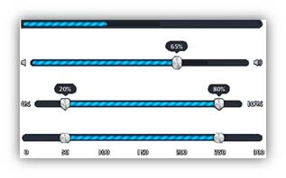
Sliders
A slider, also known as a track bar, allows users to set or adjust a value.
When the user changes the value, it does not change the format of the interface or other info on the screen

Slide 20
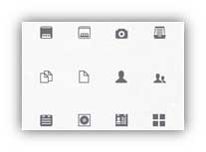
Icons
An icon is a simplified image serving as an intuitive symbol that is used to help users to navigate the system.
Typically, icons are hyperlinked.

Slide 21
Image Carousel
Image carousels allow users to browse through a set of items and make a selection of one if they so choose.
Typically, the images are hyperlinked.

Slide 22
Information Components

Slide 23
Notifications
A notification is an update message that announces something new for the user to see.
Notifications are typically used to indicate items such as, the successful completion of a task, or an error or warning message

Slide 24
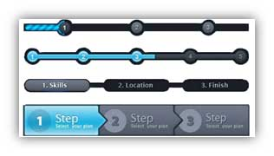
Progress Bars
A progress bar indicates where a user is as they advance through a series of steps in a process.
Typically, progress bars are not clickable.

Slide 25
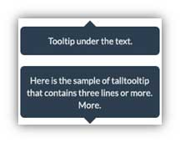
Tool Tips
A tooltip allows a user to see hints when they hover over an item indicating the name or purpose of the item.

Slide 26
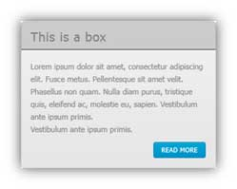
Message Boxes
A message box is a small window that provides information to users and requires them to take an action before they can move forward.

Slide 27
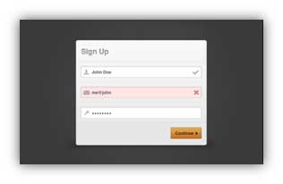
Modal Window (pop-up)
A modal window requires users to interact with it in some way before they can return to the system.

Slide 28
Containers

Slide 29
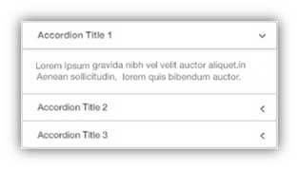
Accordion
An accordion is a vertically stacked list of items that utilizes show/ hide functionality.
When a label is clicked, it expands the section showing the content within.
There can be one or more items showing at a time and may have default states that reveal one or more sections without the user clicking

Slide 30
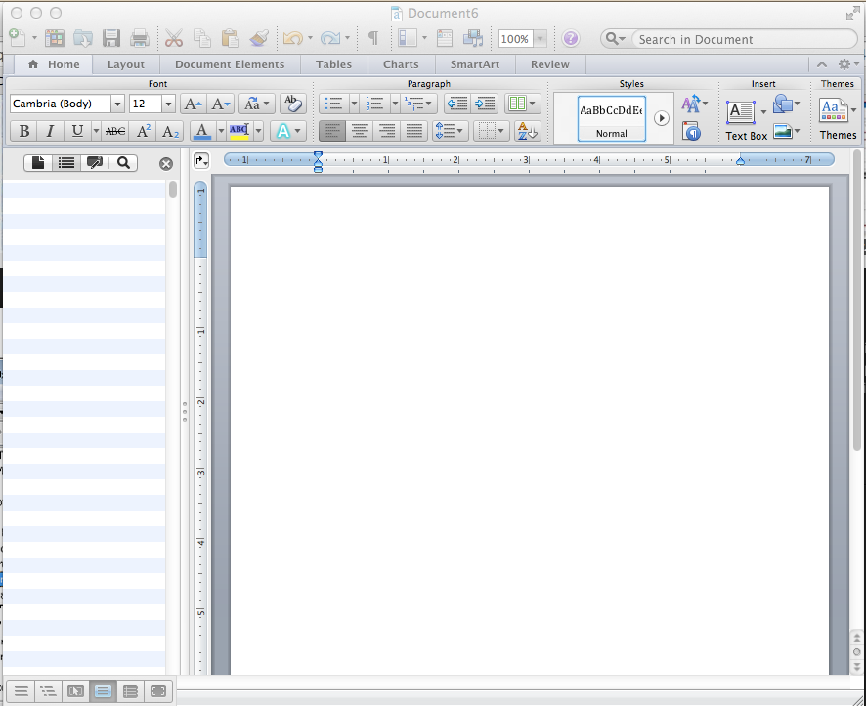
MS Word Window
Title Bar
Menu Bar
Tool Bar
Tree View
Data View

Slide 31
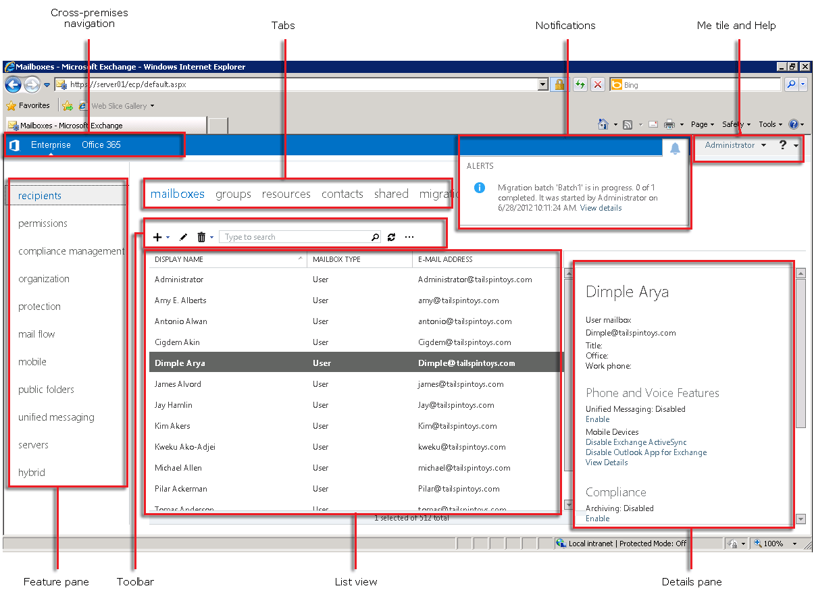

Slide 32
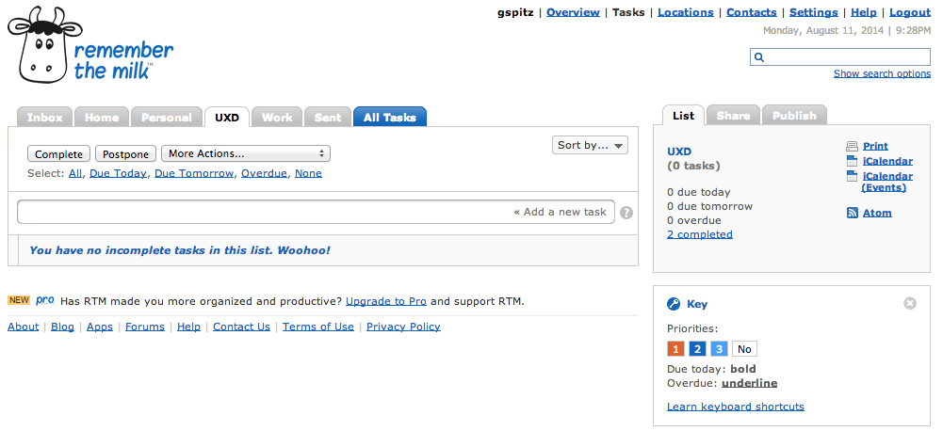

Slide 33
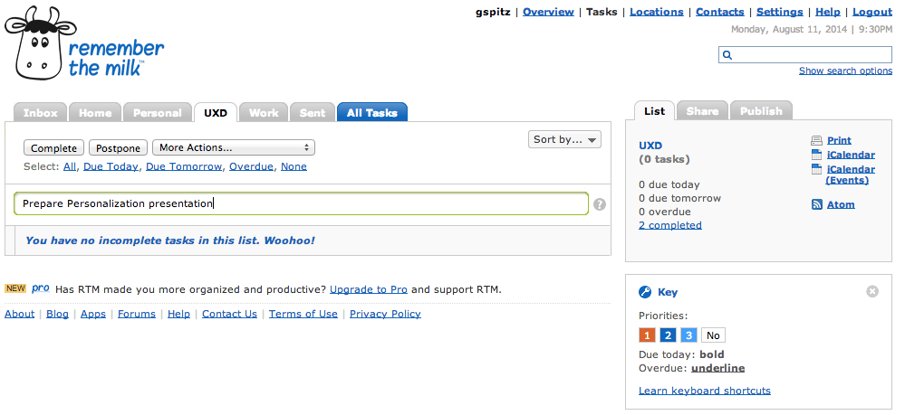
So how do I save this task?
Click on Enter-Not Visible

Slide 34
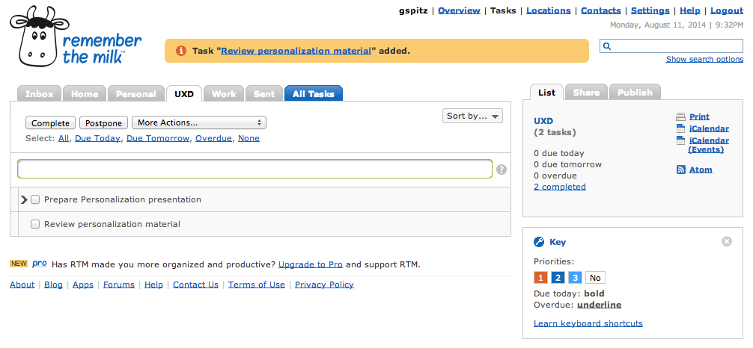
Nice feedback about task completion

Slide 35
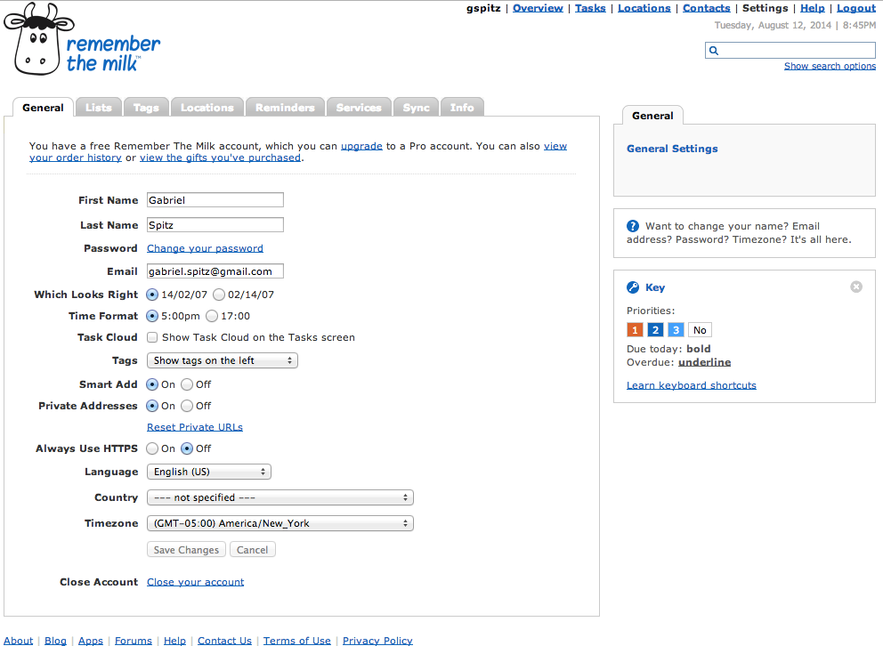

Slide 36
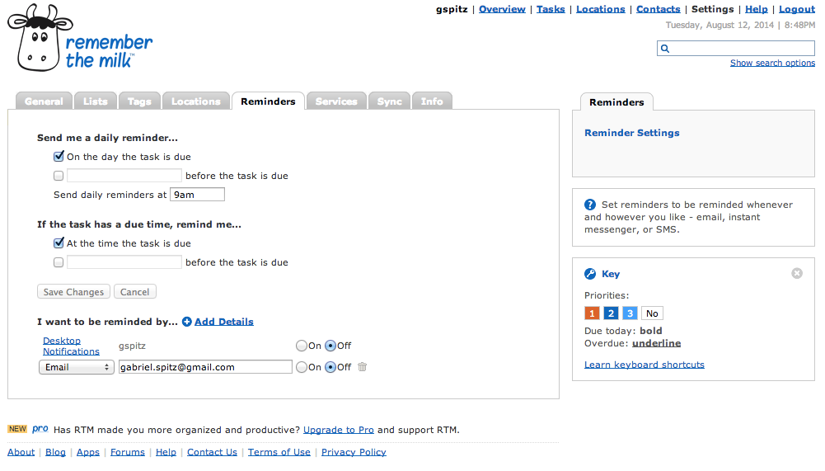
Poor labeling; it is not congruent with the options
One needs to Check the option before entering information
Else the textbox is unavailable.
One does not know what they can enter in the textbox
The combination of Checkbox and Textbox is poor

Slide 37
Summary
UI is composed of atomic components
Adhering to their standardized usage will facilitate consistency
When in doubt check it out

