Slide 1
User Interface Design Process
Lecture # 2

Slide 2
This Week
Understand the User Interface Design process
Gather info for designing a user interface for a vending machine
Design the Interface

Slide 3
Why a Design Process?
Help focus us on Usability Criteria
Ensure a systematic approach to the design effort
Minimize rework

Slide 4
Usability Criteria
Effective interaction is determined by and measured using Usability Indicators
Martijn van Welie (2001)

Slide 5
User-Interface design - Steps/Goals
Understand What is the problem who are the users what do they do
Think how will users work in the future
Evaluate
Ideas, concepts, designs
Design
An aesthetically pleasing and consistent interface
Conceptualize the user interface and interaction

Slide 6
User Interface - Design Method
User interviews & contextual observations
Task scenarios and walkthrough
Usability Assessment
Graphical screen design
Participatory design, Usability principles, Design patterns

Slide 7
Understand

Slide 8
Understand – Objectives
Build an understanding of the design problem
Identify the business problem that we intend to solve
Describe the users; what are their characteristics, likes, dislikes, goals and needs
Describe how and where we expect users to use the product/application

Slide 9
Understand– Methods
Meet with Product team and identify the design problem, scope, and goals of the product
Meet actual and/or virtual users to figure out who they are, what they do, how do they do it today and what are their key needs
Identify Perform a competitive analysis of similar products or solutions to identify trends and benchmark what is out there

Slide 10
Think

Slide 11
Think
While I call out “Thinking” as a separate step, it is often integrated with the Conceptualized step
Design → Think and Think → Design
We use images to stimulate and guide thinking and we use thinking to guide the design

Slide 12
Conceptualize

Slide 13
Conceptualize – Objective
Build a clear and shared vision of the product or application we want to build
Depict how the user interface will appear to users
Help ensure that key user tasks are accounted for-generate additional use stories and modify the design
Select and wireframe the most suitable design ( one that meets most of the requirements)

Slide 14
Conceptualize – Deliverables
Establish an overall conceptual model and sketches of the solution – the overall pattern, interaction style, metaphors
Create Task Model to describe the interaction
Create Page-wireframes to describe the interface (dialogue) concept
Create and review Application-wireframe to tie the interaction and interface design together within the context of user intention
Add new use stories, if needed, to ensure effective and comprehensive design

Slide 15
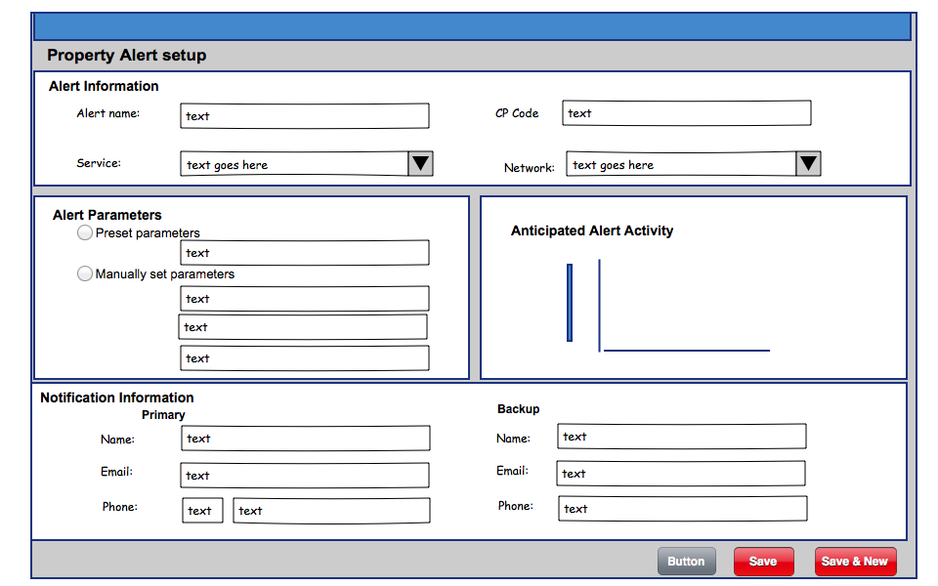
Low Resolution Wireframe

Slide 16
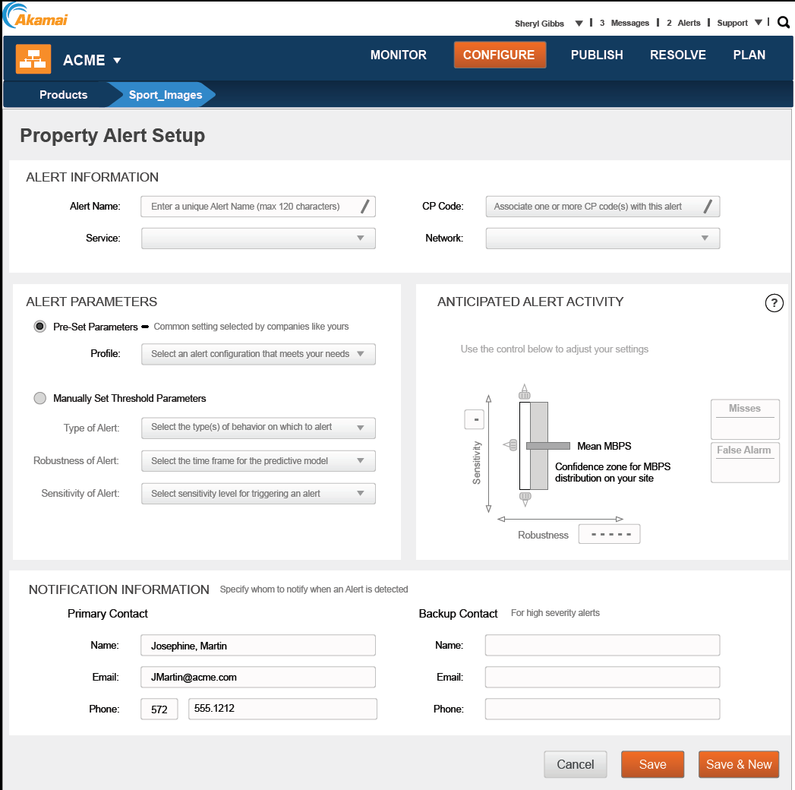
Wireframes

Slide 17
Visual Design

Slide 18
Visual Design
Create a compliant and aesthetically pleasing rendering of the application wireframes
Ensure clarity and simplicity at the user interface
Help new users quickly master product usage by adding guidance and instruction where needed

Slide 19
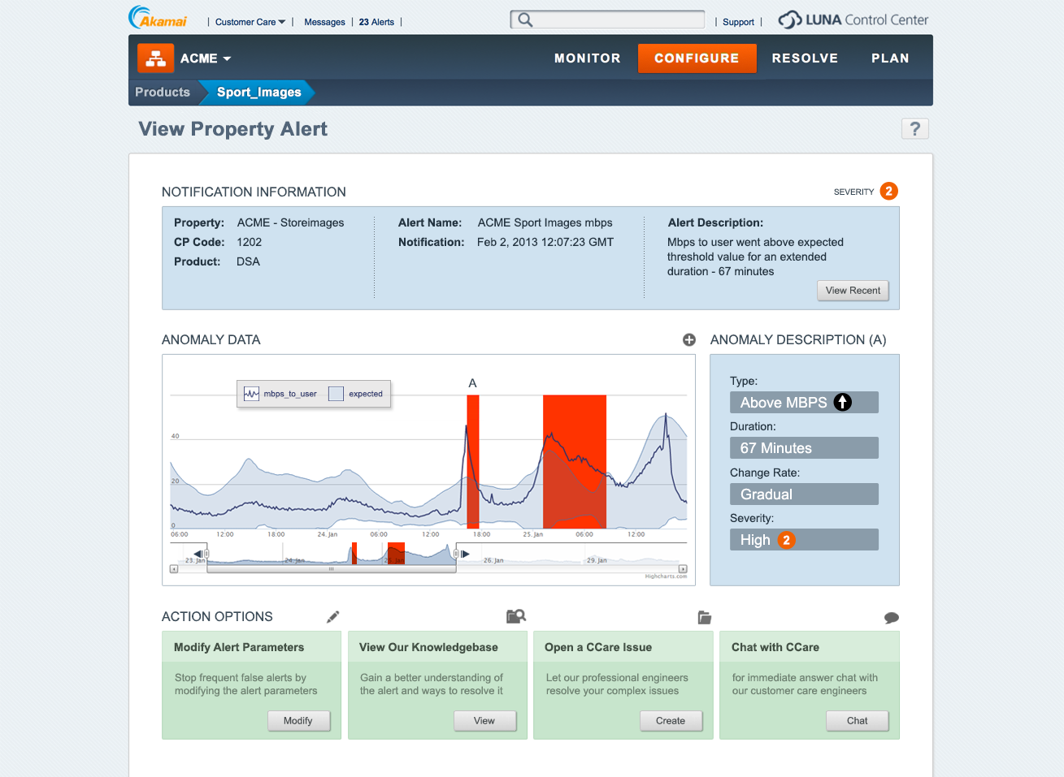
Visual design

Slide 20
Evaluate

Slide 21
Evaluate
Provide constructive and actionable input to specific design questions/issues
Continuously verify proposed design solutions
Ensure usability both at the micro and macro level

Slide 22
Evaluate - Methods/How
Utilizing a mix of evaluation methods including:
User interviews
Local and remote usability tests
A/B testing compering design alternatives
On-line surveys

